Slide 1
Decommissioning TPPs in India
Environmental, social and financial aspects
September 21, 2023
Social Considerations
for Decommissioning Retired Thermal Power Plants
Session 3

Slide 2
Potential impact of TPP decommissioning
1. Impact on workforce-
a, Loss of income for formal and informal workers
b. Uncertain job and income prospects
2. Impact on the local community-
a. Reduced economic activities
b. Reduced businesses/investments
c. Demographic changes- outmigration)
d. Reduced services (such as investments in social infrastructure and services- schools, healthcare centres, etc. by companies/CSR
3. Impact on public revenue- taxes, etc.

Slide 3
Nature of impact on workforce/community
Economic dependence and impact categories
Formal workers engaged in TPPs
Indirect
Induced
Direct
Workers such as those engaged in ash transportation from fly ash ponds
Informal workers engaged in TPPs
Local economic activities that have been induced by the TPP- businesses, service centres, etc.
About 0.18 million workers are engaged formally.
Additionally, large number of people engaged informally; about 1.5-1.7 times of the formal workforce as per district assessments.

Slide 4
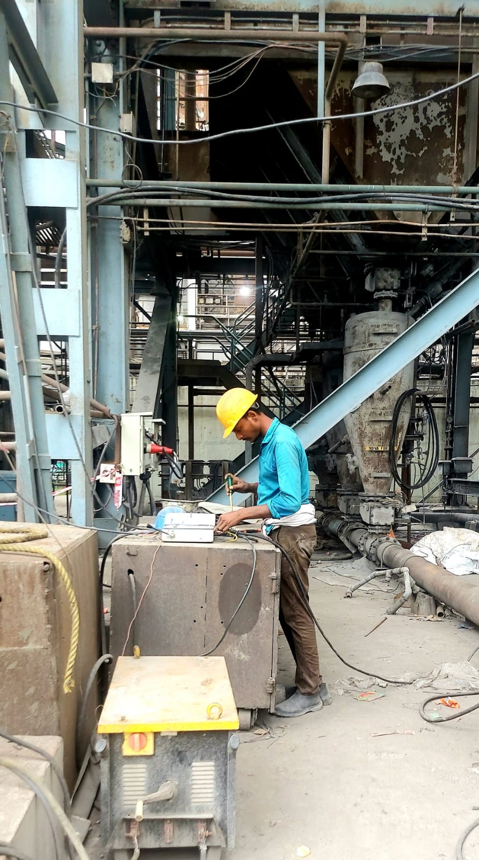
Addressing potential impacts
Strong laws and associated institutional mechanisms.
Company-specific policies/plans for workforce transition and social transition.
Stakeholder engagement.

Slide 5
Existing regulatory context
Regulatory provisions | Focus
Industrial Disputes Act, 1957 (subsumed within Industrial Relations Code, 2020) | Lay-off, retrenchment-related provisions in case of industrial closure. Retrenchment preconditions - Written notice three-months in advance; pre-approval of the government. Compensation for retrenchment- equivalent to 15 days of average pay for every completed year/any part over 6 months. The IR Code also gives provision for developing a “worker reskilling fund” to provide training to the retrenched worker. The fund is equivalent to 15 days’ wages and is to be paid within 45 days.
Contract Labour Regulation and Abolition Act, 1970, (subsumed within Occupational Safety, Health and Working Conditions Code, 2020 | Deals with contract worker’s during their tenure. Applicable to establishment or manpower supply contractor that employed 20 or more contract workers on any day in the past 12 months. Not designed for social security, compensation or reskilling support.
Social Security Code 2020 (subsumed various social security-related laws) | Formulation of welfare schemes by the central and the state government(s) for providing social security benefits to unorganised workers. Development of a Social Security Fund. Establishment of ‘career centres’ for worker’s support

Slide 6
Key limitations & Proposed interventions
Limitations
Interventions/Reforms
The labour laws need to be revised and strengthened to address workforce transition issues for various types of workers during decommissioning.
A social impact evaluation (alongside EIA) need to be undertaken.
A workforce transition plan or a social transition plan need to be developed alongside the decommissioning plan based on the impact evaluation.
Platform for tripartite dialogue between government, industry and the workers representatives need to supported .
The existing labour laws are primarily focused on addressing and settling disputes that may arise between the employer and the employee/worker.
The laws are not designed to address workforce issues during decommissioning- Skilling, transition support, etc.
Absence of a workforce transition planning and social transition planning mechanisms.

Slide 7
Thanks.

