Slide 1
Session 1: Inaugural
iFOERST Presentation: Setting the Context
August 18, 2023

Slide 2
India’s impressive RE installed capacity growth
Over 100 GW of RE and thermal capacity has been added in India since 2012.
As growth of thermal slowed down in recent years, with 11 GW added since 2019, RE capacity increased 48 GW.
India’s installed capacity growth (GW)
125 GW
Source: CEA

Slide 3
Demanding path to future RE ambitions
Given the significant immediate target and massive long-term need, success hinges on how efficiently barriers to growth can be addressed.
176.49 GW
Installed capacity (July 2023)
Capacity under implementation
Capacity under tendering
Capacity development to be initiated
Target of 500 GW by 2030
Requirement of 2500-3000 GW by 2050
88.81 GW
51.43 GW
183.27 GW
Source: Lok Sabha Question, July 2023

Slide 4
Projected increase in RE procurements
To meet the RPO requirements by 2030, RE generation would need to increase five times.
Several ‘low-RE’ states would need to increase the RE procurement 10 to 30 times relative to the current level of procurement.
Existing and required RE consumption in low RE states (MUs)
India’s total RE generation in 2022-23 | 203,552 MUs
Projected RE procurement requirement in 2026-27 | 685,866 MUs
Projected RE procurement requirement in 2031-32 | 1,071,887 MUs
Source for 2021-22: Respective SERCs;
Note: Projections for 2031-32 is based on the notified non-hydro RPO requirement for 2029-30

Slide 5
Source-wise optimal RE growth by 2030
RE growth will continue to be driven by solar, but a more balanced growth needs to be planned going forward for grid optimization.
Source-wise current installed and future optimal installed capacity (MW)
Note: Base optimal scenario as per CEA 2023 study; includes BESS of 41,650 MW/208,250 MWh

Slide 6
Challenge – Disparity in RE growth and state capacity
Grid-wise installed capacity (GW)
RE growth has so far been limited to six to seven states.
Most REDAs struggle with limited capacity, experience and expertise.
Significant scope for knowledge sharing, capacity building and deliberations on new strategies.
NR: 27.1
NER: 0.5
ER: 2.6
WR: 35.4
SR: 48.9
Source: MNRE

Slide 7
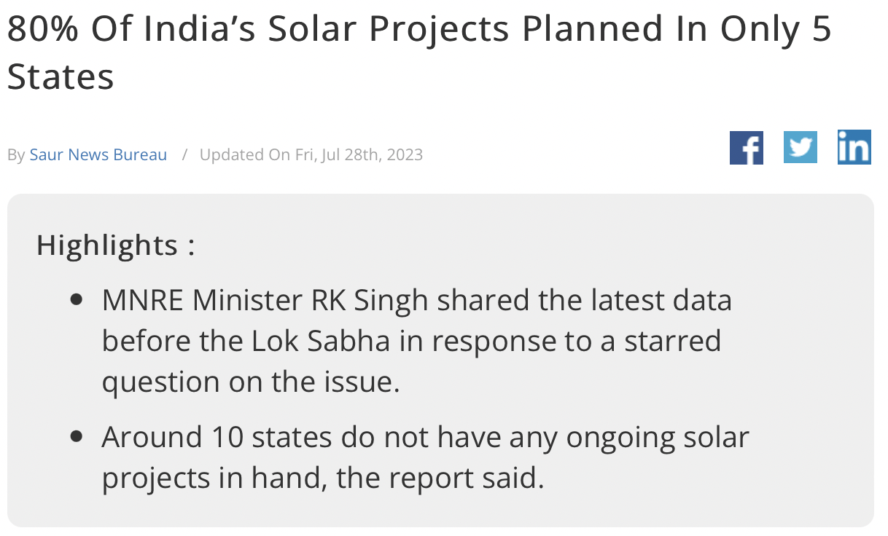
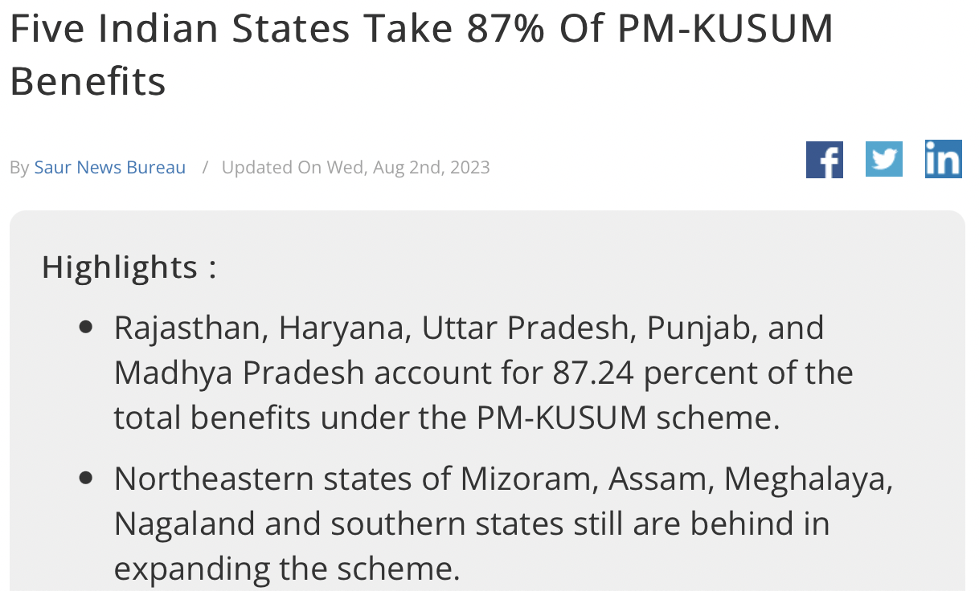
Growing attention on this issue

Slide 8
Future of REDAs
What will be the role of REDAs beyond traditional scope of work (MNRE and state scheme implementation)?
What needs to be done to strengthen REDAs of low-RE states?
What are the national and state policies needed for balanced RE growth?
What reforms are needed in the national and state policies to meet the massive RE growth targets?

Slide 9
Workshop objective & agenda
Objective: To develop a roadmap and reform agenda for REDAs, deliberate on institutional challenges, and identify strategies for the future.
Agenda
Session 1: Inaugural
Session 2: Evolving role of REDAs
Session 3: Focus on the critical challenges
Session 6: Focus on institutional best practices
Session 5: Focus on state policy
Session 4: Roadmap for the reform

Slide 10
Thank you, and Welcome!

