Slide 1

Just Transition of Coal-based Power Plants in India
A review of legal and regulatory provisions
Mandvi Singh | October 12, 2022

Slide 2
Background
Thermal power generation is a delicenced activity under Section 7 of the Electricity Act 2003.
Board of Directors of generation companies free to take closure decision, and inform Central Electricity Authority. Grid security is the only imposed technical consideration.
However, decommissioning is a complex ‘project’ that goes beyond plant retirement. It enatils complex set of technical, environmental, social and economic interventions:
  On the environmental front – ensure clean-up, remediation and decontamination of plant site
  On the labour font – (a) compensate workforce for economic loss and (b) implement just transition measures (reskilling and reemployment)
  On the land front – create new economic and environmental opportunities through repurposing of plant or redevelopment of site
Crucial to assess adequacy of requirements and resources for ensuring a just decommissioning.

Slide 3
Plant closure related laws & regulations in India

Slide 4
Environmental laws and regulations
No laws mandate clean-up and remediation works in a time-bound manner
  EIA Notification, 2006 is silent on the decommissioning aspects.
  Forest Conservation Act, 1980 doesn’t specify decommissioning.
  Decommissioning is not mentioned in Air or Water Act.
  No requirement for developing a decommissioning plan.
But if a power plant is dismantled, then multiple laws kicks-in, as dismantling and remediation qualify as ‘new activity’.
  Multiple consent and clearances required as identified by CPCB’s a draft Environmental Guidelines for Decommissioning a Coal/Lignite-Fired Power Plant

Slide 5
Environmental laws and regulations for remediation
Power plant decommissioned
Plant left 'as-it-is', without dismantling
Plant to be dismantled and site remediated
No law/regulation mandates clean up and remediation – plant owners can maintain site as per current EC & CTO conditions.
Undertake EIA & develop an EMP (suggested by CPCB draft guidelines published in 2021).
Secure new CTO or modified existing CTO under Air and Water Acts
Comply with the following:
Hazardous & other Wastes (Management & Transboundary Movement) Rules, 2016
Construction and Demolition Waste Management Rules, 2016
Fly Ash Utilization Notifications
Local municipal laws
Comply with health & safety related laws
4. No requirement for contamination study, at any stage

Slide 6
Environmental laws/regulations for redevelopment
Power plant repurposed/site redeveloped
Repurposed in sectors listed
under EIA Notification, 2006
Repurposed in sectors not listed
under EIA Notification, 2006
CTE and CTO from SPCB
EIA study and EC from MoEF&CC or SEIAA/SEAC based on sector.
CTE and CTO from SPCB

Slide 7
Land-related laws
Freehold land
Leased Non-forest Land
Leased Forest Land
Remains with GENCO
Shareholders decide on remediation and repurposing
Reverted to landowner (mostly govt), on or before lease period
Dismantling/remediation to be done by GENCOs as per lease contract
Land use classification remains forest
Ownership remains with state govt/FD
Land can only be used for the purpose it has been diverted
No law to mandate decommissioning
No formal mechanism to take decisions on repurposing/ redevelopment
Site can remain ‘as-it-is’ if decommissioning financially unviable
Redevelopment subject to government decision, typically a long drawn process
Remediation being linked to redevelopment decision may also be delayed
Land returned to FD after lease period
No specific conditions related to dismantling/remediation mentioned in approval letter
Land can be re-leased after fresh forest clearance by central government

Slide 8
Labour-related laws
Deals with retrenchment-related provisions in case of industrial closure
Defines preconditions - pre-approval & written notice three-months in advance
Suggests a compensation framework - 15 days’ average pay for every year of continuous service; or up to 3-months of average pay in case is an unavoidable closure scenario
Compensation framework may vary from state to state
Industrial Disputes Act, 1947
A broader framework provided under the Industrial Relations Code, 2020
Provides for constitution of a negotiating union
Introduces concept of Reskilling Fund
Provides for Fixed Term Employees to receive statutory benefits

Slide 9
Labour-related laws
Contract Labour (Regulation and Abolition) Act, 1970
Deals with working conditions and other benefits of contract labour
Subsumed under the Code on Occupational Safety, Health and Working Conditions, 2020, to be impleted, which broaden the applicability of the law
Not designed for providing any social security, compensation or reskilling supports
Social Security Code, 2020
Extends social security to all employees and workers in organised and unorganized sectors
Aims to register all the workers on an online portal
Demarcates welfare schemes under for the Central and State Government
Proposes setting up of Career Centers, provide vocational guidance, career counselling and guidance for self-employment

Slide 10
Funding-related regulations
CERC (Terms and Conditions of Tariff) Regulations, 2014 provide the framework through which inter-state power plants can recover variable and fixed costs. Replicated through state-level regulations for intra-state power plants.
  Decommissioning cost is not explicitly considered in tariff calculations
  Salvage value (10% of the plant’s capital cost) considered sufficient
  If dismantling, clean-up and remediation of TPPs are enforced through a new law, then the costs can be covered through tariff
Decommissioning costs are not part of GENCOs liability under existing financial regulations

Slide 11
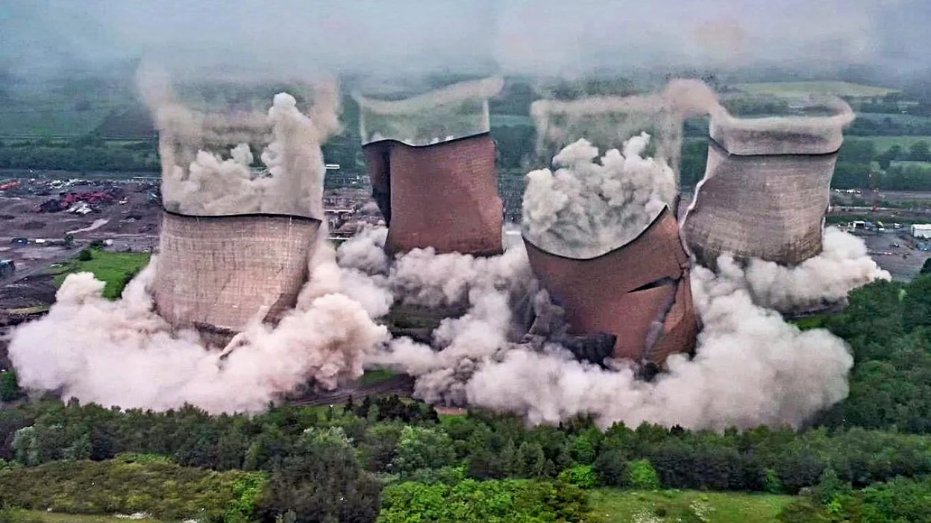
Global experience

Slide 12
432.5 GW of coal power capacity has been retired globally since 2000
Retired capacities have gradually increased - 20.5 GW in 2000-05 to 64.2 GW in 2006-10, 139.2 GW in 2011-15, & 218.1 GW in 2016-20
Varied action on closed plants
Plants left ‘as-it-is’ (common in the US)
Repurposed for energy or non-energy use
Dismantled for energy or non-energy use
Replaced with new, efficient coal units (Common in China and India)

Slide 13



Legal/regulatory action on TPP closures
In US, EPA issued factsheet for guiding decommissioning, remediation & redevelopment; Dedicated law passed by Montana
In Canada, federal approach identified for contaminated sites; local governments empowered to act on reclamation
In UK, redevelopment guided by National Planning Policy Framework
In Germany, Federal Soil Protection Act identifies strict liability for remediation work
In US, state laws have been passed laws allowing recovery of closure costs from ratepayers; Funding options and incentives identified for remediation/redevelopment
In Europe, coal closure laws passed (in Germany, Netherland, Finland etc.) provide for a payment mechanisms for plant owners to compensate for early closures.
In US, dedicated laws enacted to support just transition - Infrastructure Investment and Jobs Act in 202; similar sate level laws in Pennsylvania, Colorado and Illinios
In Germany, Code for Social Security provides for strong fundamental support for workers; addition support mechanism identified under Coal Exit Law

Slide 14
Experiences of US, Canada, UK and Germany offer key lessons
Preparing in advance important
Clean-up & remediation through mandates; not guidance
Adequate financing for clean-up and remediation needs to be provided
Proactive role of government in just transition action needed
Repurposing/redevelopment should be prioritized
Legal frameworks guiding early closure of power plants

Slide 15
Recommendations

Slide 16
Build a legal requirement for decommissioning
Amendment in existing laws: Such as, amendment in EIA notification, 2006 and in the compliance conditions for EC
For new plants, decommissioning plan should be part of the EIA study and the EMP
For the existing plants, submission of a decommissioning plan well before the date of retirement should be mandatory (say 5 years before retirement)
or
Enact a new law: Decommissioning of Industries and Power Plant Act to consolidate all environmental-related provisions & remove multiplicity in clearances & permit procedures.
It should define/identify:
  Clear timeline for decommissioning
  Procedure for development & approval of the decommissioning plan (5 years before closure)
  Single permit mechanism for dismantling works
  Procedure for compliance reporting and verification
  Grant of decommissioning certificate
  Process to obtain an integrated consent/ clearance for repurposing
  Process for certification/accrediting of specialized decommissioning companies

Slide 17
Build mechanisms for enabling efficient decisions on land
Define a clear policy on land repurposing with adequate incentivise
Set up empowered committees at central and state levels for taking repurposing decisions
Amend Land Acquisition Acts to specify dismantling and remediation standards (provide clarity in case of leasehold lands)
Build mechanisms for just transition of the workforce
Revise existing labour laws/codes from a just transition perspective
Enact a Just Transition Policy and set up Just Transition Fund
Ensure district-level just transition planning, with an integrated approach
For PSUs, develop and implement comprehensive policy for transfers, re-employment, reskilling and worker rehabilitation

Slide 18
Provide financial framework to fund decommissioning
Establish a clear liability on GENCOs to decommission plants, to develop plans and estimate costs
Set up a funds corpus for decommissioning (similar to Escrow account created for coal mine closure)
Create an institutional set-up at central-level for administering the fund, i.e. for approving plans, collecting funds, administrating funds and giving final clearance
Mandate disclosure of decommissioning cost as liability for all generation companies
In case of merchant power plants, ensure that decommissioning costs are included in cost of doing business. Certain amount of funds can be held in an Escrow account, as a surety for decommissioning and reimbursed later
Prudent approach needed for efficiently addressing these issues in case of bankruptcy

Slide 19
Thank You
mandvi@iforest.global

Slide 20
