Slide 1
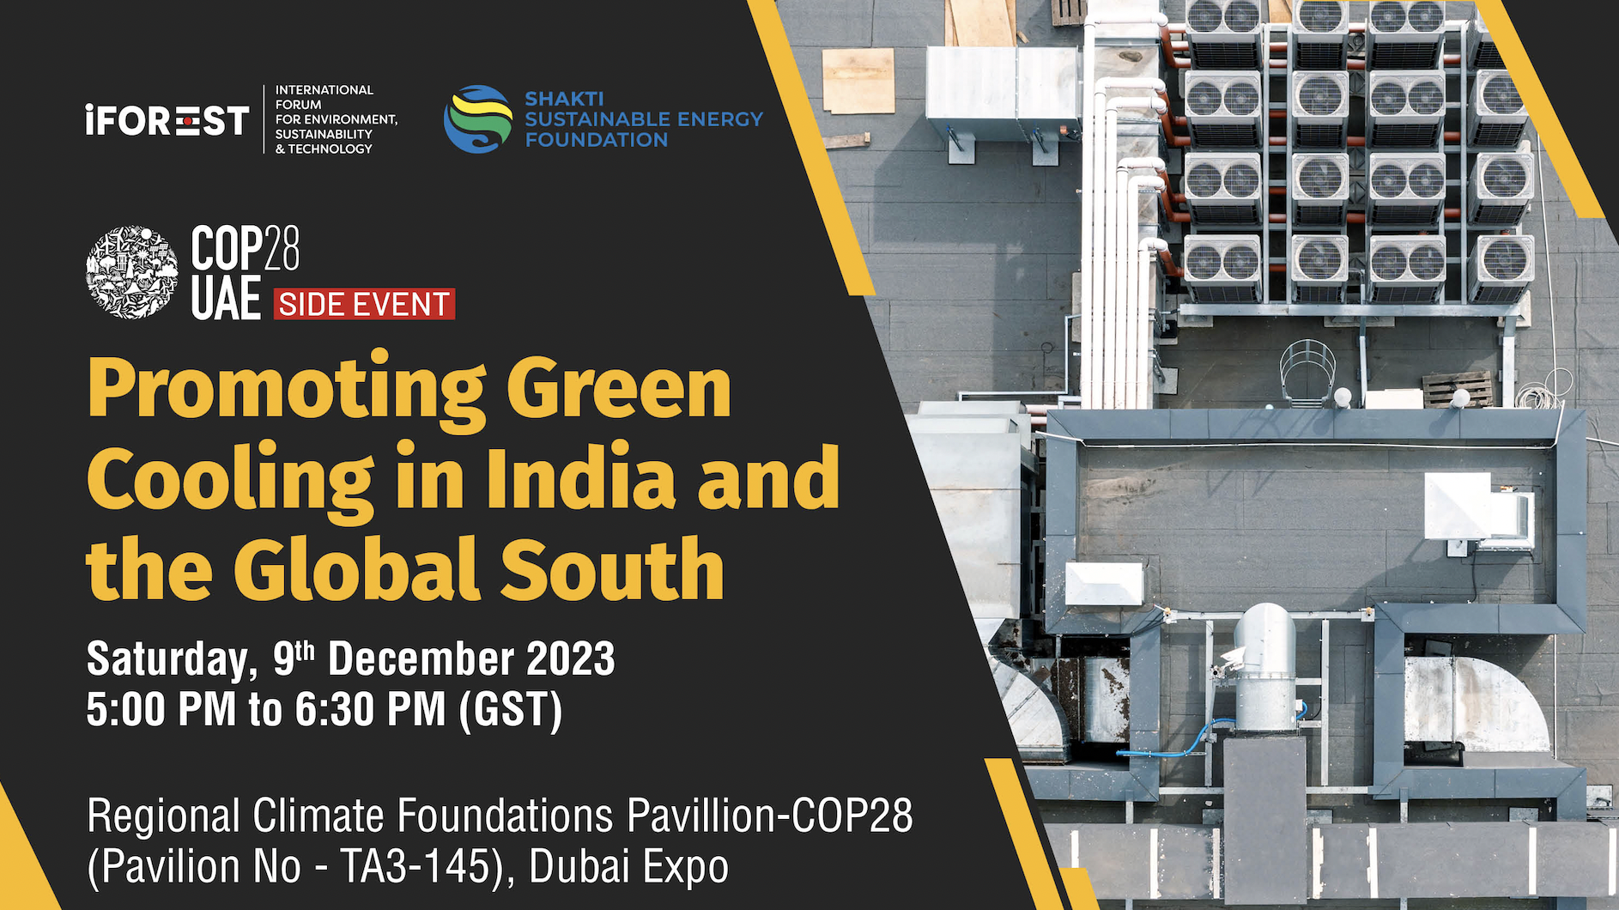

Slide 2
Promoting Green Cooling in India and the Global South
COP28 Side Event
GIZ Proklima | 09.12.2023 | Philipp Denzinger, Project Manager, Proklima International

Slide 3
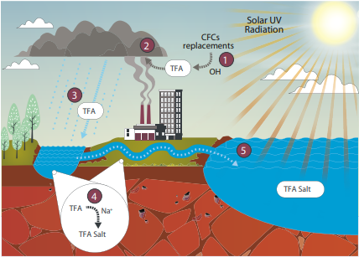
Present and future refrigerant options
Refrigerant | Type | GWP 20 | GWP 100 | PFAS | TFA
R22 | HCFC | 5690 | 1960 | No | No
R404A | HFC blend | 7208 | 4728 | Yes | Up to 20% R134a (4%), up to 10% R143a (52%)
R407A | HFC blend | 4944 | 2262 | Yes | Up to 20% R134a (20%)
R410A | HFC blend | 4850 | 2256 | Yes (R125) | No
R134a | HFC | 4140 | 1530 | Yes | Up to 20%
R32 | HFC | 2690 | 771 | No | No
R513A | HFC/HFO blend | 1823 | 673 | Yes | Up to 20% R134a (44%), up to 100% R1234yf (56%)
R1234ze(E) | HFO | 4.94 | 1.37 | Yes | Up to 10%
R1234yf | HFO | 1.81 | 0.501 | Yes | Up to 100%
R744 | Natural (CO₂) | 1 | 1 | No | No
R717 | Natural (Ammonia) | <1 | <<1 | No | No
R600a | Natural (Isobutane) | <<1 | <<1 | No | No
R290 | Natural (Propane) | 0.072 | 0.02 | No | No
PFAS (forever
chemicals) are not manageable, and all efforts should be undertaken
to avoid them as completely as possible.
Per- and polyfluoroalkyl substances (PFAS) are a large class of synthetic chemicals that increasingly detected as environmental pollutants and linked to negative effects on human health. Trifluoroacetic acid (TFA) is an ultra short chain type of PFAS, commonly found in the breakdown of f-gases.
Sources: IPCC, 2021: 6th Assessment Report of the IPCC (Table 7.SM.7). Behringer, D. et al. 2021: Persistent degradation products of halogenated refrigerants and blowing agents in the environment, Final report.
UNEP, “Refrigeration, Air conditioning and Heat Pumps Technical Options Committee, 2022 Assessment Report”, 2022.
Climate-friendly alternatives to HFCs (europa.eu)
Notes:
HFCs have high GWP values, pending to be phase down and out in the short future.
HFCs, and especially HFOs, are PFAS substances, where one of their degradation products is trifluoroacetic acid (TFA), short chain type of PFAS.
R134a subs → R513A, R1234ze(E), R1234yf
R404A, R407C subs → R452A, R454C
R410A subs → R454B, R32

Slide 4
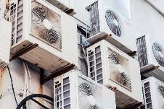
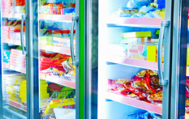
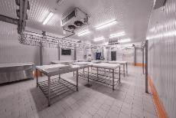
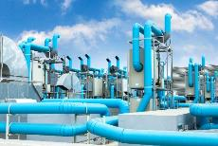
Climate-friendly solutions exist for (almost) all applications
AC/HP
Refrigerators
Commercial refrigeration
Chiller
Industrial refrigeration
Transport refrigeration
HC
CO₂
HC
CO₂
HC
NH₃
CO₂
NH₃ HC
NH₃
HC
CO₂
HC
HC: Hydrocarbons (e.g Isobutane, Propane) CO2: Carbondioxide NH3: Ammonia
Notes:
15/12/2023

Slide 5
Best practice examples from India and the Global South

Slide 6
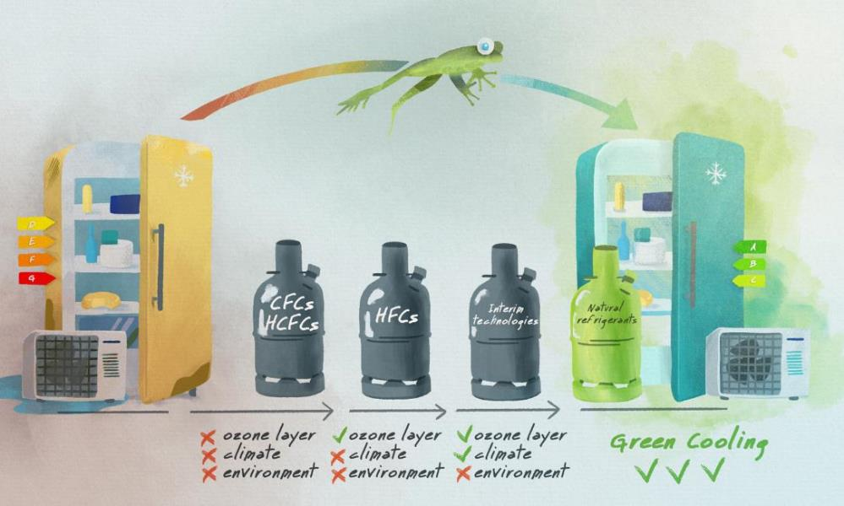
Avoiding emissions by "leapfrogging” to Green Cooling
Instant switch to highly energy-efficient technologies with natural refrigerants without relying on environment- and climate-damaging interim technologies.
Use of natural blowing agents for insulation materials.
Use of solar powered technologies combined with ice storage.

Slide 7
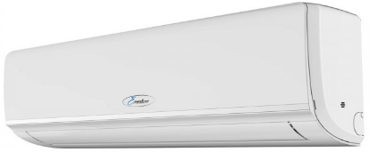
Indian success story on R290 split ACs
German (BMU IKI) funded GIZ R290 AC conversion project in 2011 jointly with Godrej
Up to 1 million R290 split ACs have been produced and installed
Fixed speed and inverter units (12, 18 & 24k) with high energy efficiency
Godrej successfully demonstrated that R290 split ACs are a climate, environmentally friendly and highly energy efficient technology
R290 compressor optimisation regarding energy e
Sources: IPCC 6th Assessment Report (GWP 100 or 20 years data)

Slide 8
Conventional split ACs compared to Green ACs (high energy efficiency and natural refrigerant (R290)
R22 (GWP 1960/5690)
1 kg = 1.9 / 5.6 tonnes CO₂eq
R410A (GWP 2256/4850)
1 kg = 2.3 / 4.9 tonnes CO₂eq
Over lifetime (10 years) per AC:
Reduced energy consumption, on average by 5,000 kWh*
Significant cost reduction for consumers and government
Reduced emissions on average of 5-10 t CO₂eq*
Conventional technologies
Equivalent to emissions of:
Approx. up to 3 return travels India - Frankfurt
Approx. 15 - 30,000 km
GWP 0.02/0.072
(1 kg = 0.02 / 0.072 kg CO₂eq)
Sources: IPCC 6th Assessment Report (GWP 100 or 20 years data) *depending on grid emission factor, running hours, etc.

Slide 9
CO2, NH3 and HC demonstration units in India
Hotels
School kitchen
Pharmaceutical industry
Seafood processing plants
Fishing vessel

Slide 10
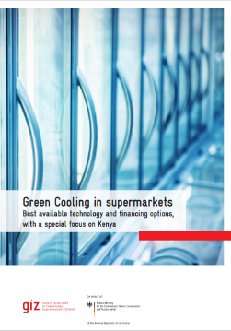
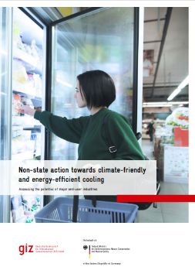
Example: Switching Supermarkets to Natural Refrigerants & Energy Efficiency
Two Pick n Pay supermarkets switched to combined CO2 cooling systems in South Africa
Reduction of direct emissions of ozone and climate damaging refrigerants of more than 500.000 kg of CO2 equivalent
Approximately 350 supermarkets switched up to date to CO2 in South Africa
Centralized hydrocarbon supermarkets systems are also being installed in Thailand (water loop), South Africa and in Kenya (semi plug-in) in near future and offer another excellent technology solution
Read more: IKI Website

Slide 11
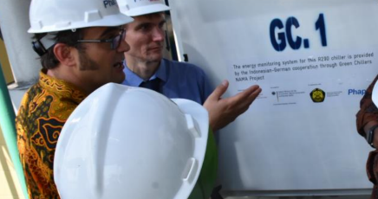
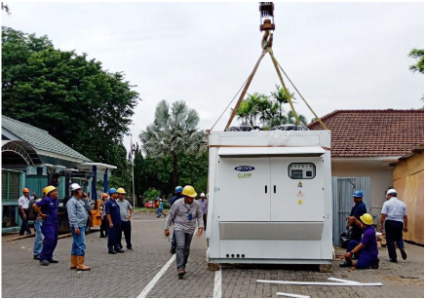
Example: Installation of R-290 Chillers for Industry and Businesses in Indonesia
 | HFC Chiller (R-22) | Green Chiller (R-290) | Difference (%)
Unit Price (USD) | 37.822 USD | 55.886 USD | 32%
Energy Efficiency Ratio (EER) | 2,7 | 3,6 | + 25%
Energy Consumption (kWh/year) | 783,442 | 572,238 | - 37%
Annual Energy Cost (USD) | 61,584 | 44,982 | - 37%
Lifecycle Cost, LCC (USD) | 434,686 | 348,372 | - 25%
Direct Emissions (tCO2eq) | 451 | 0,34
Indirect Emissions (tCO2eq) | 12,367 | 9,033
Total Emissions (tCO2eq) | 12,819 | 9,034 | - 42%
Global Warming Potential (GWP) | 1810 | 3
Ozone Depletion Potential (ODP) | 0.055 | 0
Internal Rate of Return (IRR) % | 21 %
Payback Period (years) | 1,04 %
Photo: MEMR 2022
Source: CCAC, 2019
Photo: GIZ 2018

Slide 12
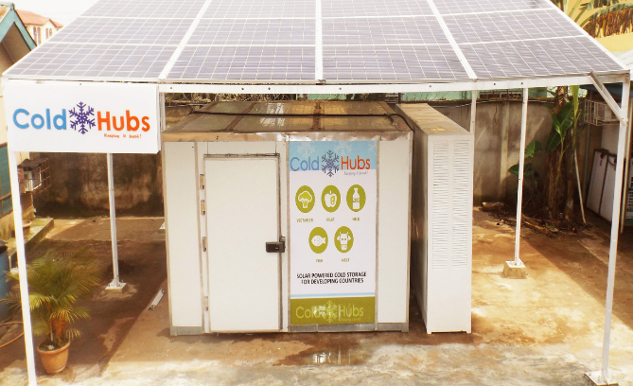
Example: Solar Powered Walk-in Cold Room: Cold Hubs – Nigeria
24/7 off-grid storage and preservation of perishable foods
“plug and play” modular
Using natural refrigerant R290 (monobloc)
120mm insulating cold room panels retain the cold
Batteries + inverter (newer generation with ice storage)
Pay-as-you-store subscription model
Around 100 units installed in Nigeria
Newer installations also come with ice storage instead of batteries
© coldhubs

Slide 13
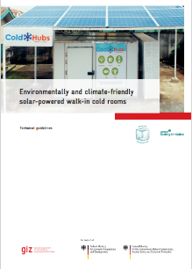
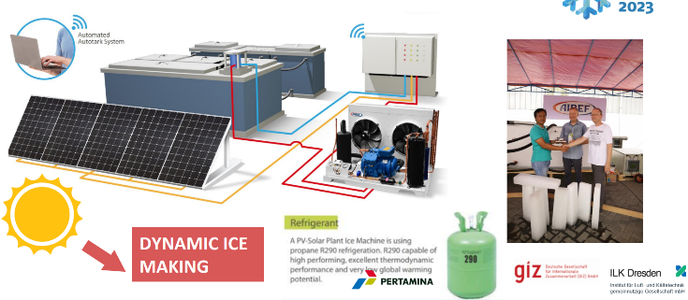
Examples: Solar Powered Solutions with R290 R290 ice production in Indonesia R290 walk-in fish cold room Kenya

Slide 14
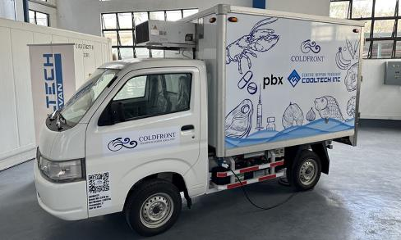
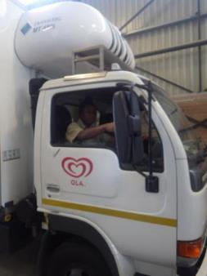
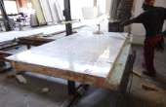
Examples: Transport Refrigeration using Natural Refrigerants
Demonstration and market induction in South Africa (IKI/BMU/GIZ Transport refrigeration)
Demonstration in Burkina Faso
(EU/BMZ/GIZ ROCA)
Demonstration in the Philippines (UNIDO/ATMOsphere)
Natural refrigerant R290 or R600a (or CO2)
Outstanding efficiency
Zero planned maintenance
Reduces carbon footprint of the fleet
Use of natural blowing (ultra low GWP) agents for foam / insulation materials and improved body design
Picture: Hydrocarbons21.com
Pictures: GIZ Proklkma

Slide 15
QCR System is essential – only certified technicians are permitted to work on flammable refrigerants!
(1) Qualification
We provide 14 modules - freely accessible and free of charge for partner countries
We check refrigeration curricula according to international standards
We support training institutes in revising their curricula and, if necessary, integrating modules into their curricula
We conduct trainings for teachers (Trainings of Trainers)
(2) Certification
We develop certification systems together with the national authorities
We provide exemplary examination questions and "Competencies to assess“
We cooperate with certification bodies and expand their capacities
We develop systems to recognize prior learning experiences
(3) Registration
We advise on national registration systems and identify needs
We advise on licenses for technicians

Slide 16
Publications
Regular publications regarding GIZ Proklima activities and cooling sector along with TERI, India in their newsletter “NewsTrack”
Latest revised Syllabus of GIZ Proklima Good Service Practices Technicians and Trainers handbooks in 2018/2019
…and many more publications under www.green-cooling-initiative.org

Slide 17
Philipp Denzinger
Proklima International
Philipp.Denzinger@giz.de
www.green-cooling-initiative.org

