Slide 2
AEEE
Jayanta Chaudhuri
Director, AEEE

Slide 3
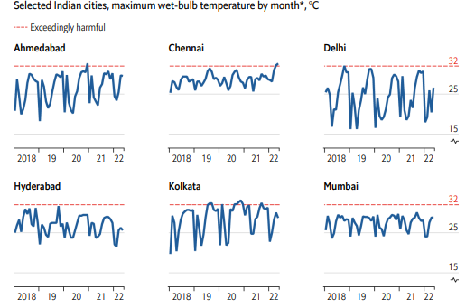
India’s worsening heat crisis
 | India | China | US
Population | 1.4 bn | 1.4 bn | 0.3 bn
Cooling Degree Days (CDD) | 2,200 | 650 | 650
Person CDD | 3 tr | 30% India | 6% India
India's AC penetration is very low compared to its cooling demand.
11 out of 15 warmest years in India occurred after 2007.
A study in the Lancet estimates the annual number of deaths related to high temperatures in India to be 83,700.
All India peak power demand met reached a record high of ~240 GW on 1 September 2023.
75% of the Indian labour force work in heat-exposed sectors such as agriculture, mining, and construction.
Only 8%-10% of Indian households have air-conditioning.
The wet-bulb temperature (WBT) has started to touch the 32°C mark and is expected to breach 34°C in the next 8 years. Even heat-adapted people cannot carry out normal outdoor activities past a WBT of 32°C.
Compiled from various sources including The Economist, WEF, IMD, Ministry of Power, McKinsey, etc.

Slide 4
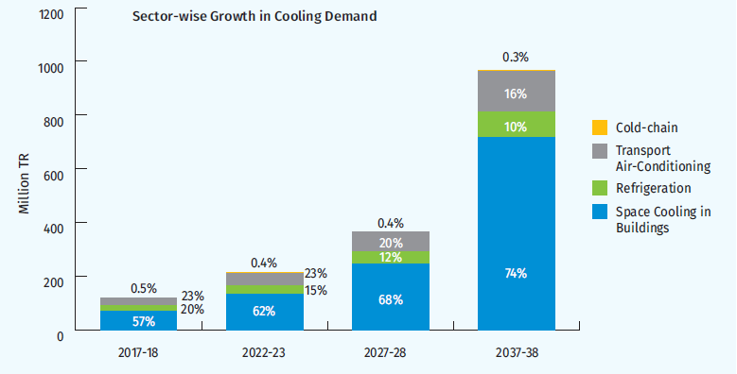
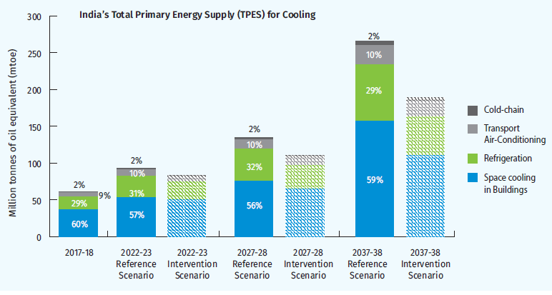
India: A perfect cooling storm
Cooling demand in India is projected to grow 8X in the next two decades;
the cooling demand in buildings can be reduced by 20% in two decades through climate-appropriate building envelopes driven by the higher adoption of building energy codes
The total primary energy consumption for cooling will grow 4.5X in the business-as-usual scenario, with a 30% savings potential
More results: https://aeee.in/data-analysis/india-cooling-action-plan-a-guided-graphical-tour/

Slide 5
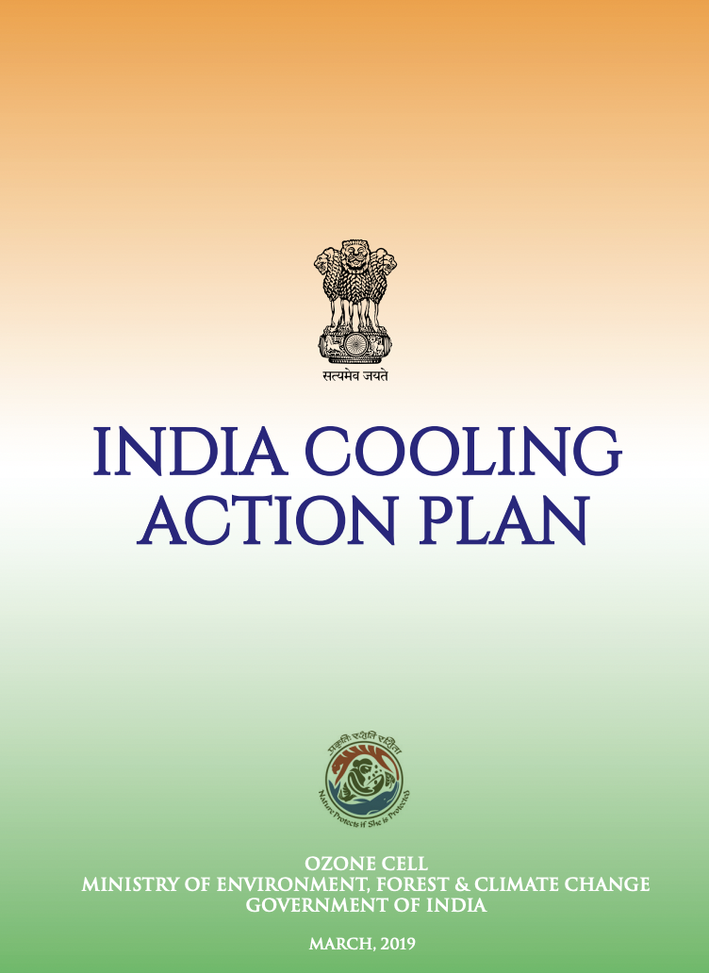
Cooling = complexity
Multiple ministries:
No one and everyone owns cooling!
Public enterprises
Industry, private & knowledge sector
MSDE, NSDC, ESSCI
DST, Mission Innovation
BEE
RAMA
REGMA
ACMA
CSIR
NCCD
EESL
Manufacturers
R&D Institutions
IPUA
National priorities & agendas
International commitments/priorities:
Housing For All
Doubling Farmers’ Income
AMRUT – Public Transportation
FAME India
Smart Cities Mission
Energy Conservation Building Code
Others…
NDCs
Kigali Amendment to the Montreal Protocol
SDGs
State Departments & ULBs
The answer lies in integrated policymaking!
Sachar, S., Kumar , S., Goenka, A., and George, G. 2021. India Cooling Action Plan: Lessons in integrated cross-sectoral policymaking. ECEEE Summer Study 2021.

Slide 6
India Cooling Action Plan development
CONTEXT MAPPING &
ICAP PLANNING
COOLING DEMAND ASSESSMENT
INTEGRATION & ICAP SYNTHESIS
1. MAPPING INDIA’S COOLING CONTEXT
2. ICAP PLANNING & PRE-WORK
3. ASSESSMENT OF SECTOR-SPECIFIC COOLING DEMAND
4. MAPPING INDIA’S COOLING CONTEXT
5. INTEGRATION OF SECTOR-WIDE ASSESSMENTS
6. ESTABLISHING RECOMMENDATIONS & PATH FORWARD
Leveraging existing research and body of work. For example:
Demand Analysis for Cooling by Sector in India in 2027
HCFC Phase-Out Management Plan Stage-II
Can India’s Air-Conditioning Service Sector Turn Climate Friendly? Evaluating the Skill Gap
MoEF&CC sets guidance for the scope and intent of ICAP
Detailed sector mapping:
Growth drivers, unique attributes
Existing policy and market levers
Sector-specific recommendations and solutions:
Future pathways to address cooling demand while neutralizing negative impacts
Prioritize actions: ease of implementation, impacts/benefits
Consider synergies with existing policies & programs
Integration:
Aggregation of the sector-specific analysis into cohesive country-wide view of cooling
Consolidation and prioritization of opportunities
Recommendations:
Synthesizing into ICAP goals and recommendations
Prioritize actions into short medium and long-term
Consider synergies with existing policies & programs
Ozone Cell establishes Working Groups (WG):
Ozone Cell convenes stakeholder workshops
7 WGs are established- each with representatives from public sector, private sector and the industry
Data-driven assessment of the cooling demand for each of the chosen cooling sectors:
Current cooling demand & associated energy and emission impacts
Future cooling demand & associated energy and emission impacts
Synergizing with existing policies and priorities:
Obtain alignment and inter-ministerial buy-in for cross-sectoral synergies
Mapping intersection with global & national commitments:
NDCs
Commitments under the Kigali Amendment
National development priorities & agendas
Facilitating collaboration and consistency among WGs:
OC and support entity establish framework for sector-wide assessments; templates for data mapping
Timelines and output expectations established
WG charters, and collaboration touch-points identified
Implementation framework:
Guidance on future implementation governance
Guidance on iterative refinement and recalibration of recommendations
Intervention scenario:
Intervention opportunities across policy, technology and market levers
Associated enegy and non-energy benefits
Identifying key stakeholders:
Government entities
Non-govt & industry entities
Sachar, S., Kumar , S., Goenka, A., and George, G. 2021. India Cooling Action Plan: Lessons in integrated cross-sectoral policymaking. ECEEE Summer Study 2021.

Slide 7
Key learnings and takeaways
Importance of a nodal/ coordinating entity that owns and drives the process
Adopting a triple-sector engagement model, right from the start
Ensuring inter-ministerial coordination and buy-in
Data is key, but need not be a show-stopper
Importance of an implementation framework
Balancing comprehensiveness and timeliness
Sachar, S., Kumar , S., Goenka, A., and George, G. 2021. India Cooling Action Plan: Lessons in integrated cross-sectoral policymaking. ECEEE Summer Study 2021.

Slide 8
South-South cooperation in climate-friendly cooling
Cambodia and Indonesia pilot the innovative NCAP Methodology, showcasing South-South cooperation
Cambodia NCAP:
Developed collaboratively by multiple entities
Aims to realize Cambodia's sustainable development vision
Establishes a national framework for collaboration in the cooling sector
Supports Sustainable Development Goals, Paris Agreement, and Kigali Amendment

Slide 9
About AEEE
Set up in 2008, AEEE supports policy implementation and enables the energy efficiency market with a not-for-profit motive
Focus Areas
Vision
Catalyze Responsible Use of Energy for a Climate Resilient and Energy Secure Future
 | Sustainable cooling & refrigeration
 | Low carbon built environment
 | eMobility
 | Smart & resilient power distribution
 | Low carbon technologies & solutions
 | Data analytics and modelling
 | State and local action
Mission
Foster a culture and market for energy efficiency by working across government, industry, and civil society organizations and assist with:
Integrating energy efficiency into India’s Climate Action, Sustainable Development, and Net-Zero Goals
Enabling equitable energy transition
Industry Members
Governance
52
NGOSource Equivalency Determination
Registered as a Society
FCRA
MCA Approval For CSR
12A & 80G
Niti Aayog Darpan ID
GST Registration

Slide 10
Organization Goals - 2030
Energy Savings: Enable 100 GW of demand offset through energy efficiency
Investment: Help create an ecosystem to facilitate INR 100,000 crores of green investment into energy efficiency interventions
Green Jobs: Undertake capacity-building programmes with partners to enable 500K+ green professionals to drive India’s net zero ambition
Our value system will drive all our actions.

Slide 11
Thank You !

